Slide 1

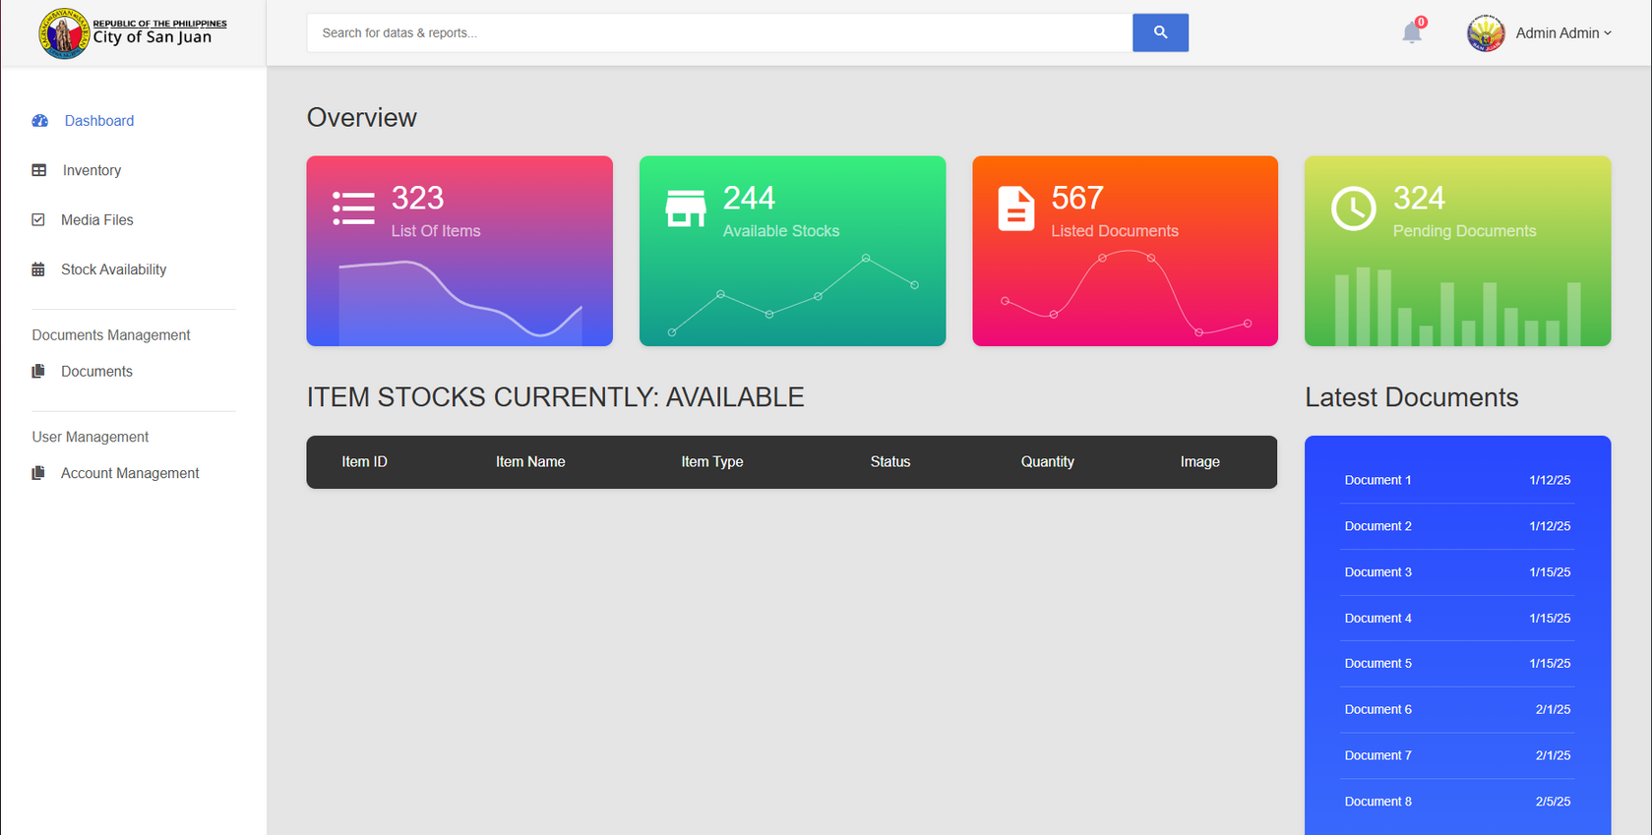
DASHBOARD

Slide 2
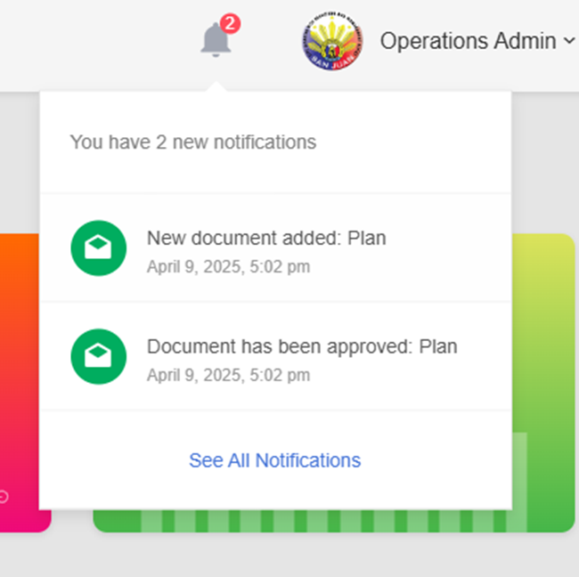

Updated functional notification for documents that are received, accomplished etc.
NOTIFICATION

Slide 3
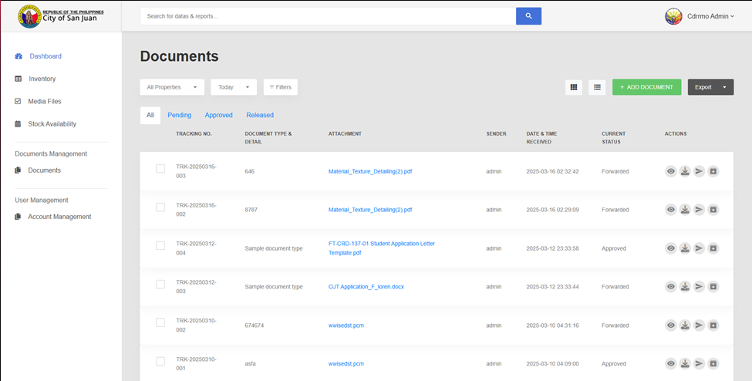
DOCUMENTS TAB

Slide 4
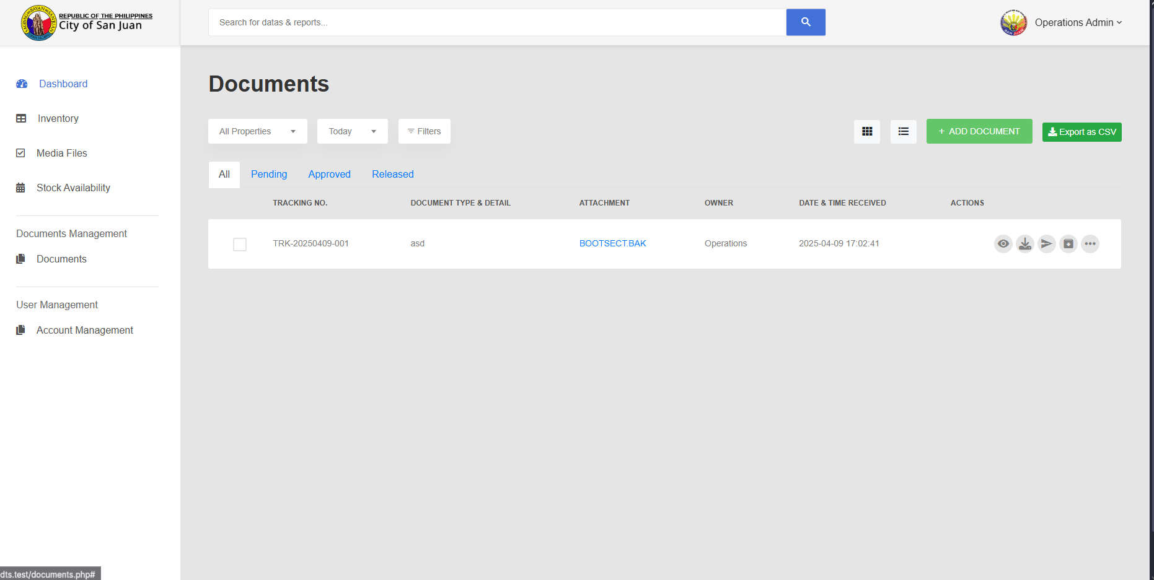
EXPORT DOCUMENTS

Slide 5
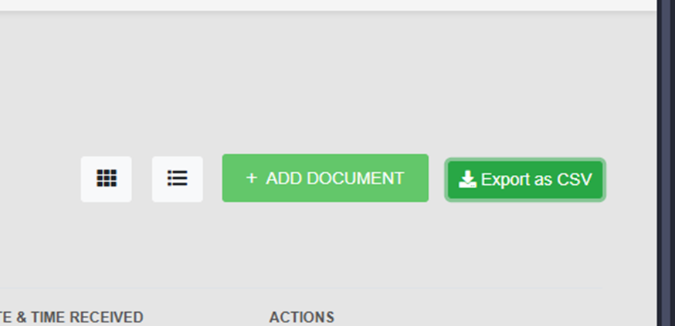

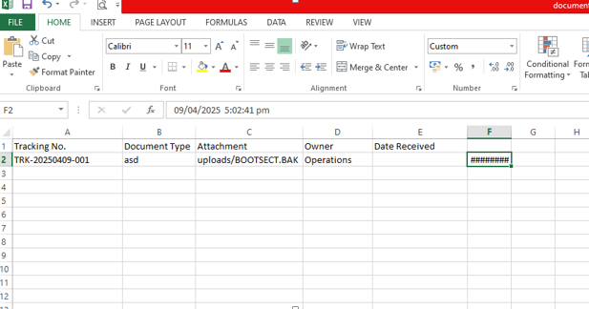
EXPORT FUNCTION

Slide 6
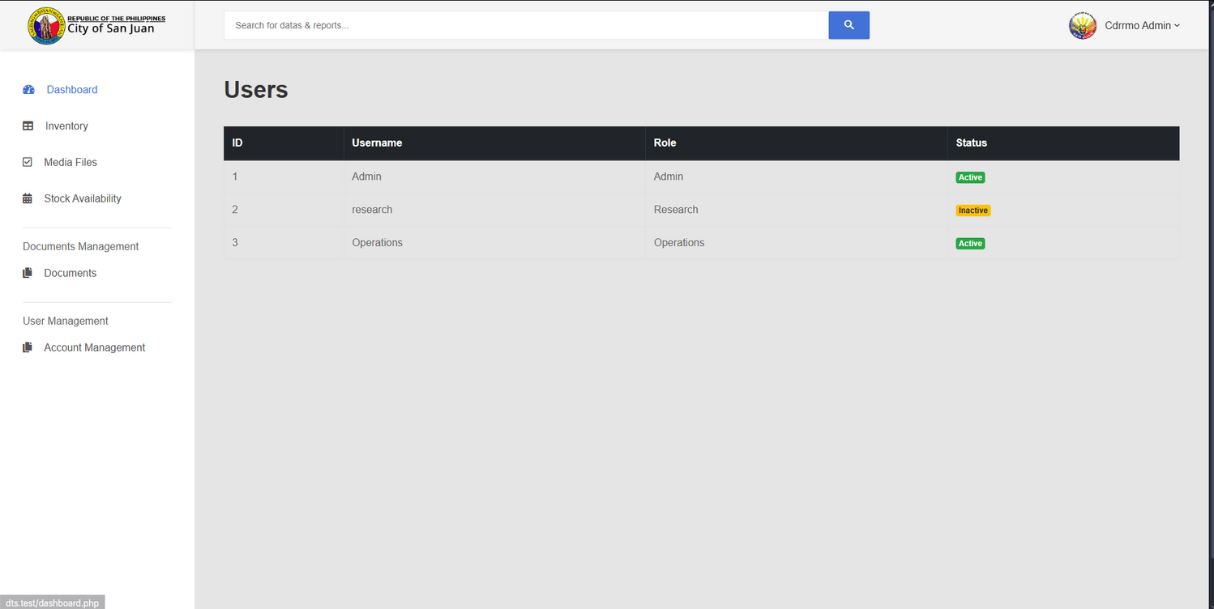
Users list shows all the currently active and inactive users
USERS LIST

